Slide 1
An Exploratory Data Analysis on Food Desert in the USA
DATAS6101 – Intro to Data Science Project
Source: ers.usda.gov
Abishek Chiffon | Keerthana Aravindhan | Mowzli Sre Mohan Dass | Robert Williams

Slide 2
Food Desert
A food desert is a geographic area, typically in urban or rural regions, where residents have limited access to affordable and nutritious food. In these areas, there is often an absence of grocery stores, supermarkets, or other sources of fresh and healthy food options
A Tract area considered to collect the census data

Slide 3



Food Desert

Slide 4

Tract area
½ mile for Urban 10 mile for Rural
Tract area
1 mile for Urban 10 mile for Rural
Tract area
1 mile for Urban 20 mile for Rural

Slide 5
Q1. Geographic Distribution of Food Deserts
A total of 51 States and 3,140 Counties are represented in the Dataset
Overall, 72,857 Rows of data has been included in the analysis

Slide 6
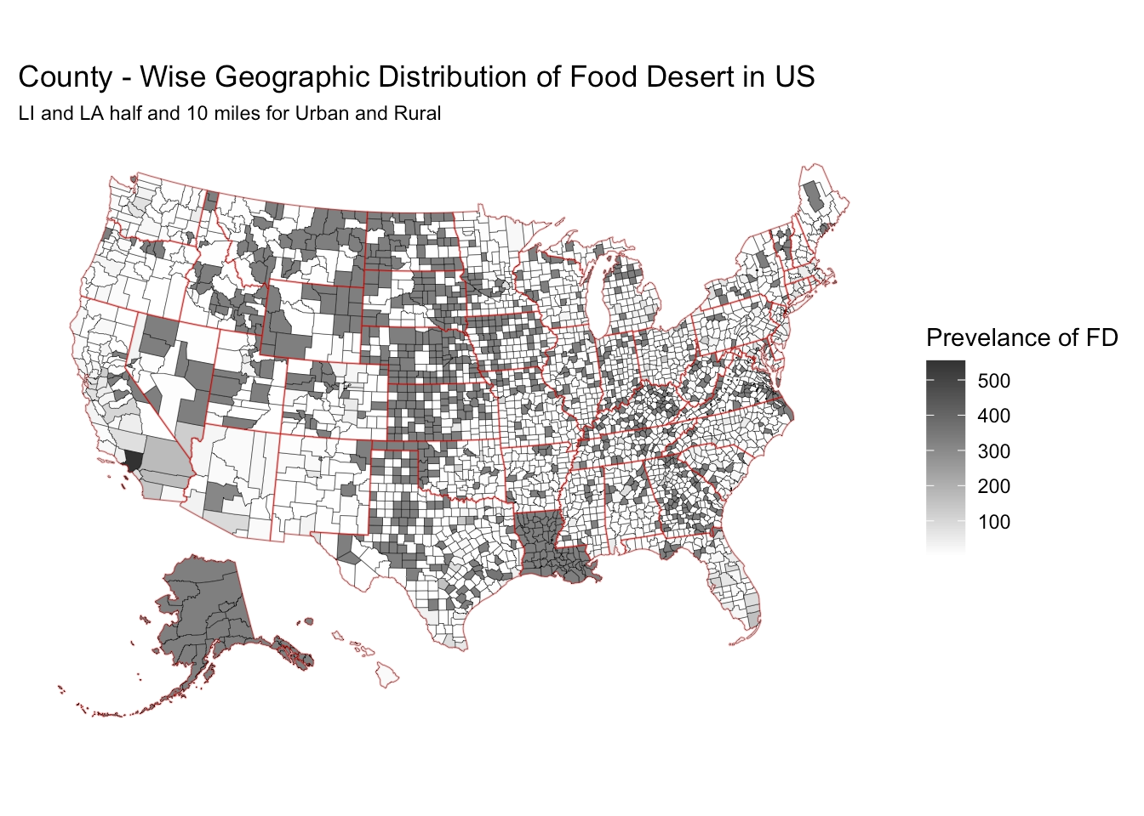
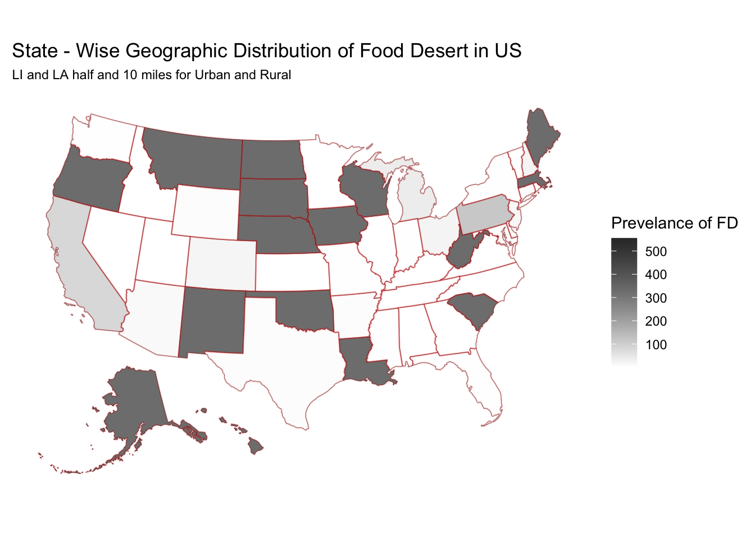
Q1. Geographic Distribution of Food Deserts

Slide 7
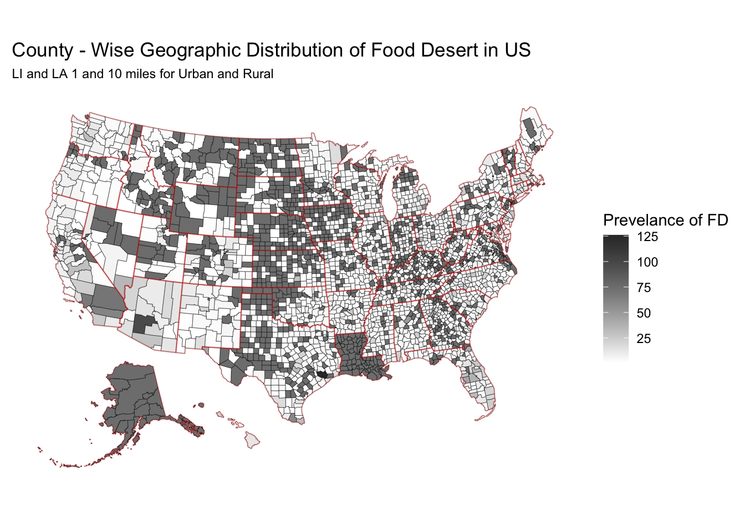
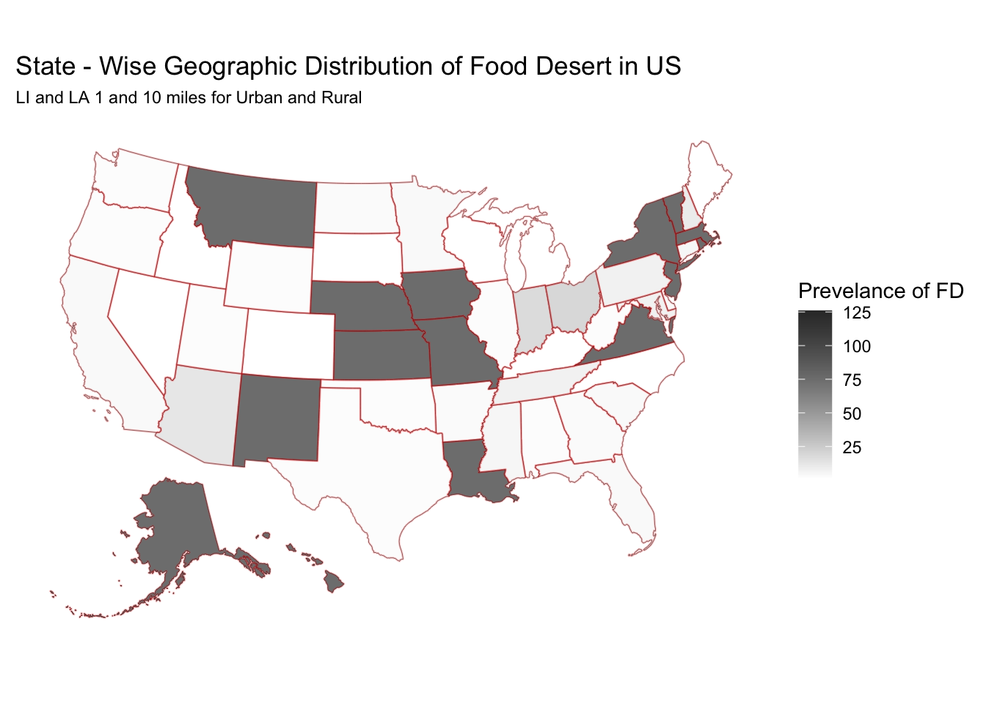
Q1. Geographic Distribution of Food Deserts

Slide 8
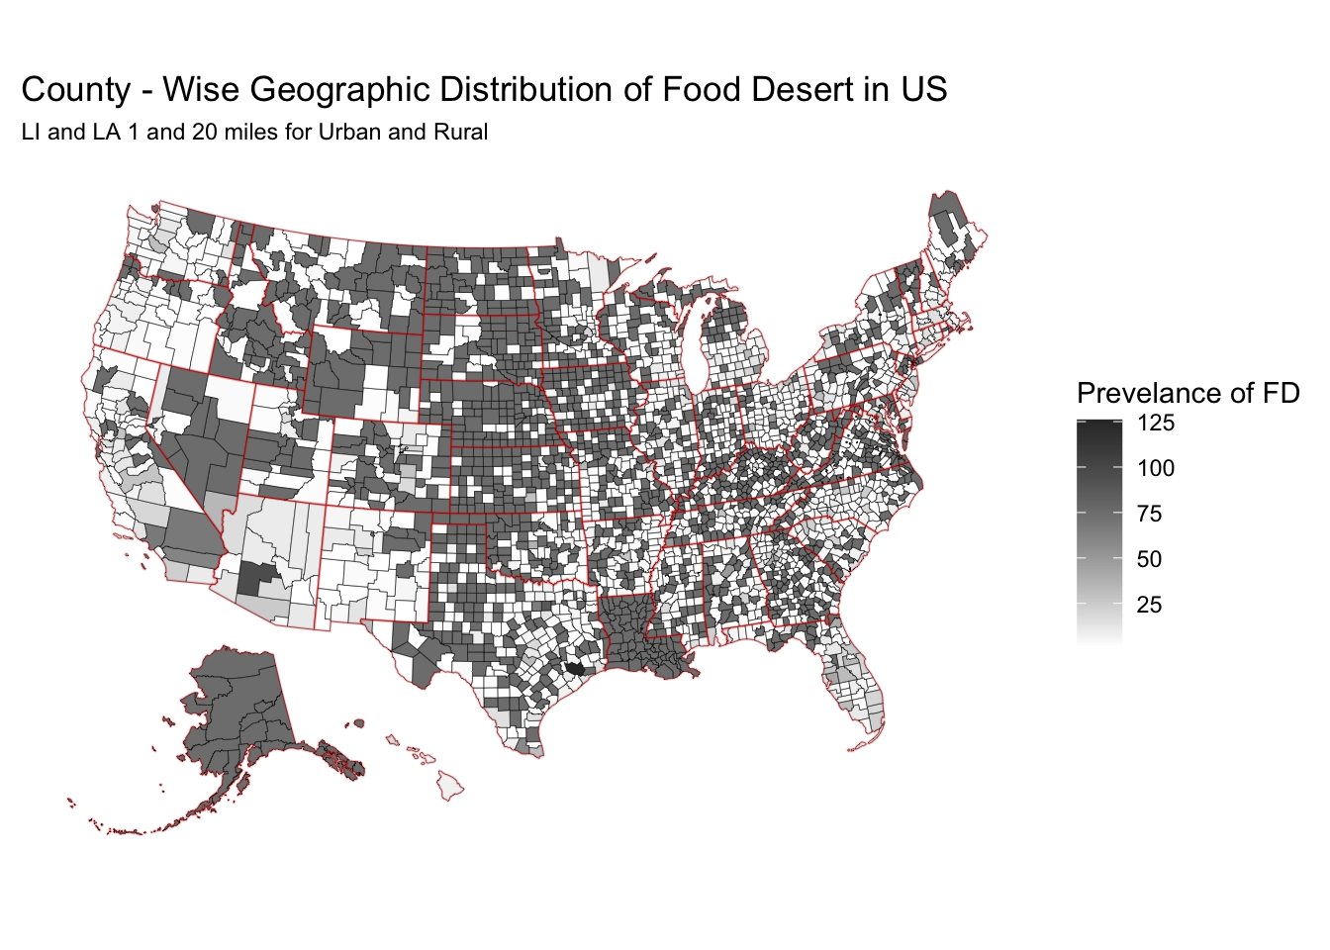
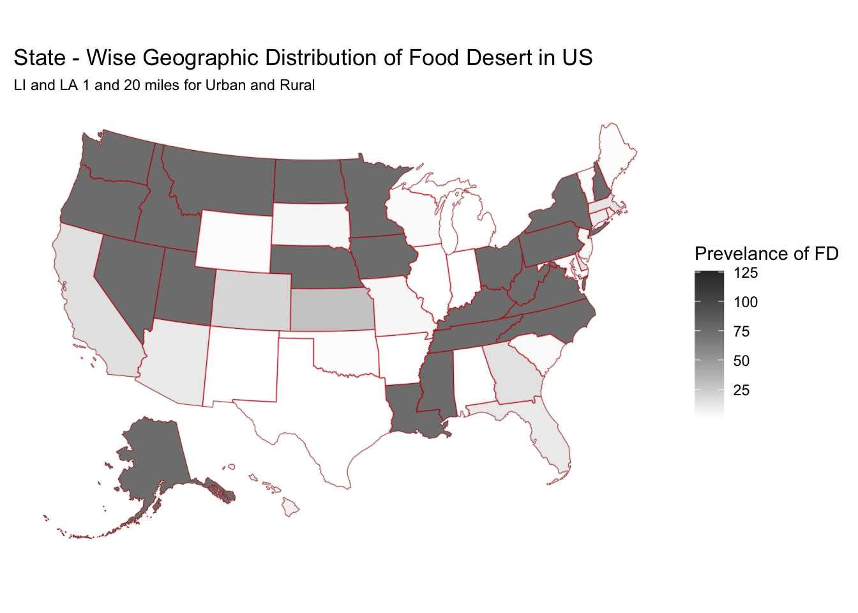
Q1. Geographic Distribution of Food Deserts

Slide 9
Q2. Urban vs Rural Classification impacts

Slide 10
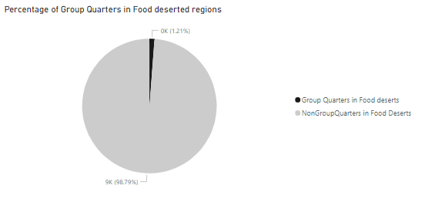
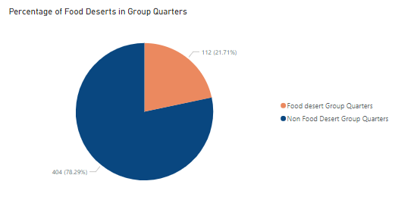
Characteristics of Areas with Group Quarters:
Group Quarters are very less in Food deserted regions.
Also, Percentage of Food deserts in Group Quarters are less compared to Non Food deserts.

Slide 11
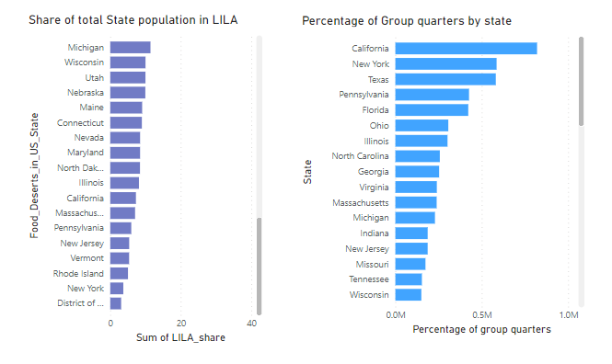
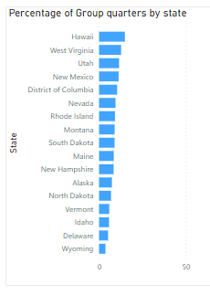
Percentage of Group Quarters tracts by States:
California and Newyork have highest group quarters tracts.
Wyoming and Delaware have least group quarters tracts.

Slide 12
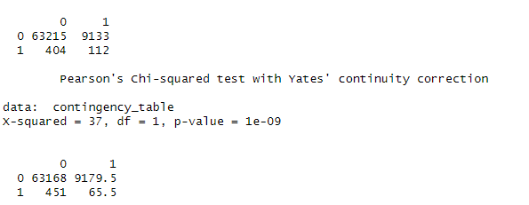
Correlation between the percentage of Group quarters and the prevalence of Food deserts
Chi-square (GOF) between GroupQuartersFlag and LILATracts_1And10:
Null Hypothesis (H0): there is no association between the two categorical variables.
Alternative Hypothesis (H1): there is an association between the two categorical variables.
Significance level alpha = 0.05
Conclusion:
low p-value - reject the null hypothesis
thus there is a significant association or correlation between "GroupQuartersFlag" and "LILATracts_1And10."

Slide 13
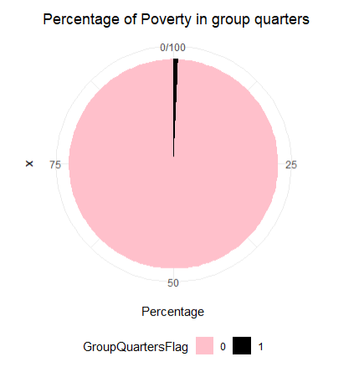
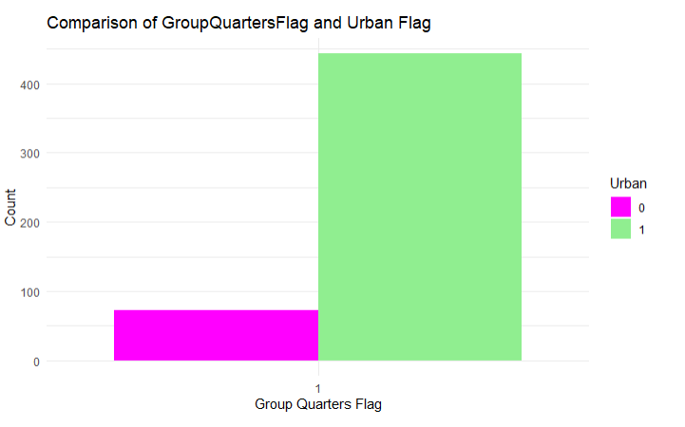
Characteristics of Areas with Group Quarters:
Group quarters are more in urban compared to Rural.
Poverty rate is more in Non Group Quarters tracts.

Slide 14
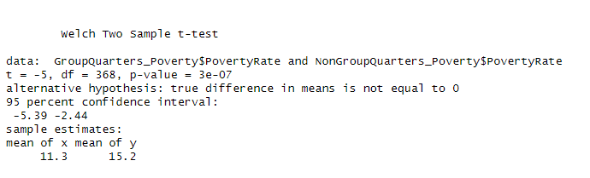
T-Test to compare the "Poverty Rate" between tracts with and without Group quarters:
Null Hypothesis (H0): The average Poverty rate are the same for with and without group quarters
Alternative Hypothesis (H1): The average Poverty rate are different for with and without group quarters .
Significance level alpha = 0.05
Conclusion :
There is a significant difference between the means.
Mean of Poverty rate is more in Non Group Quarters tracts.

Slide 15
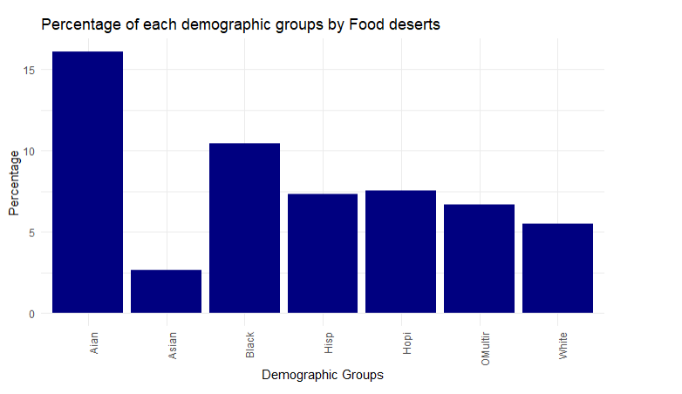
Different Demographic groups in Food Deserted Tracts:
AIAN (American Indian or Alaska Native) and black are more in Food deserted areas compared to other groups.
Least Demographic group in Food deserts - Asian

Slide 16
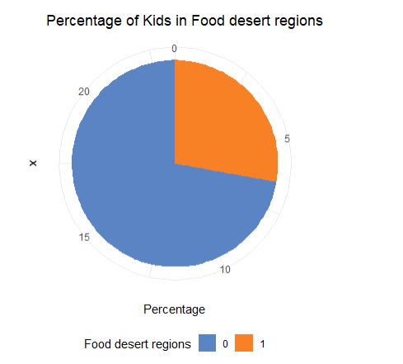
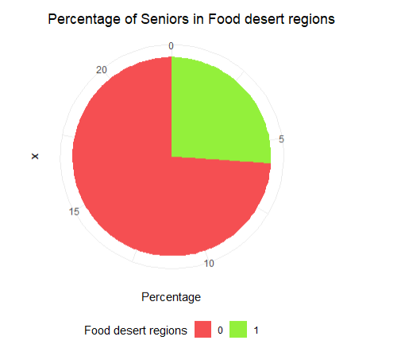
Population of Kids and Seniors in Food and Non Food deserted tracts.
Population of Kids and Seniors are more in Non Food deserted regions.
We can say, they opt for non food deserted tracts.

Slide 17
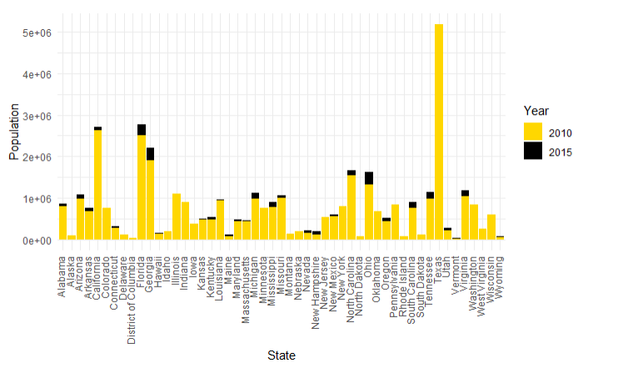
Population change in Food deserts from 2010 to 2015
In 2010, ~ 37 million of US population lived in Food deserted tracts.
In 2015, ~ 39 million of US population lived in Food deserted tracts
Increased by 2M.

Slide 18
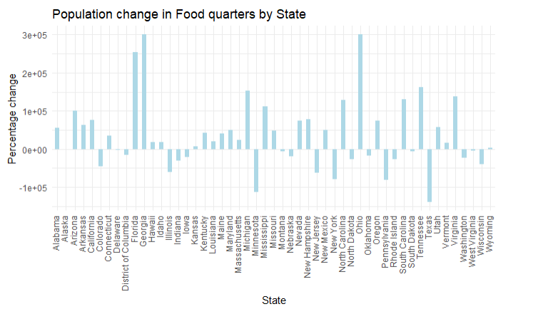
Population change in Food deserts from 2010 to 2015

Slide 19
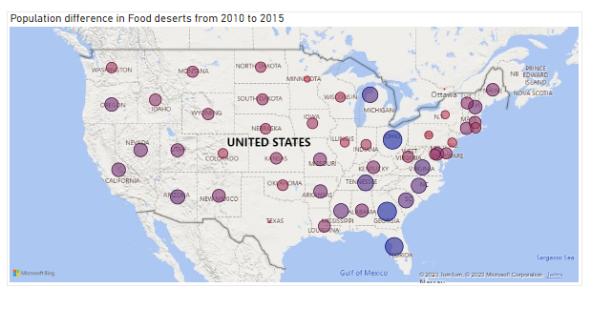
Population change in Food deserts from 2010 to 2015
– High population difference
– low population difference
Eastern side states have major change in Food desert population.

Slide 20
References
Ref 1
Ref 2

Slide 21
Thank You!

